Slide 1
Binary Numbers and other objects
Eric Prebys

Slide 2
“Numbers” in Computing
As you’ll learn if you take 118, everything in a computer ultimately reduces to 1s (TRUE) and 0s (FALSE)
  These are internally defined by voltage levels.
Numbers are made from groups individual signals, called “bits” (= “binary digit”)
In the early days of computing, the exact format of numbers depended on the type of computer and there was a lot of variation:
  Even “byte” was only defined as ”a group bits” when I was in college (sometimes 6, sometimes 8)

Slide 3
Types of Numbers
In general, there are four types of numbers:
  Unsigned Integers
  Signed Integers
  Fixed Point (really a special case of Signed Integers)
  Floating Point
Unsigned Integers are the only one with an unambiguous definition.
Signed Integers and floating-point numbers have used different representations over the years.
We’ll focus on modern standards, but it’s not impossible that you may encounter older standards somewhere down the road.

Slide 4
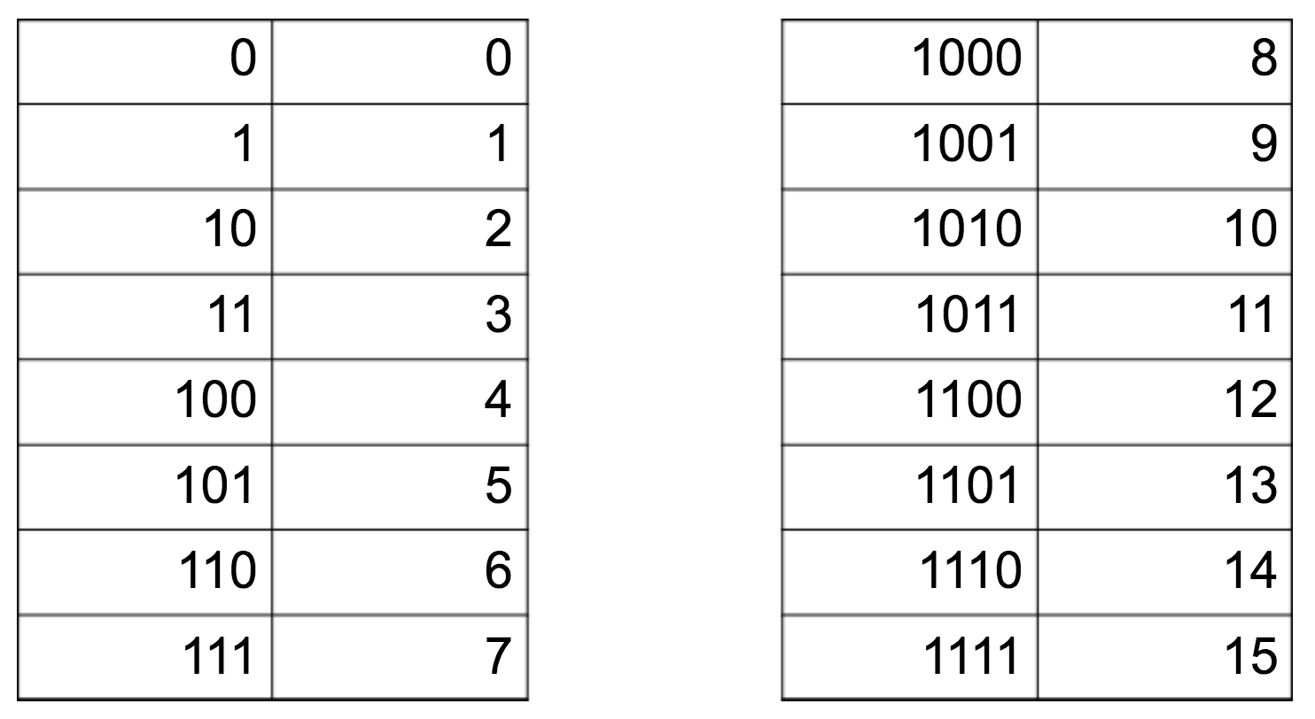
Unsigned integers (also used for addressing!)
The binary representation of unsigned integers is simply the number expressed in base-2, in which the n^{th} bit represents 2^{n} (we’ll always count bits starting at 0!)
A n-bit word has a range 0 to (2^{n}-1)

Slide 5
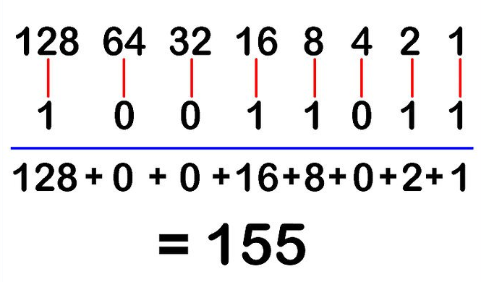
Converting from Binary to Decimal
Simply add up the values of the individual digits

Slide 6
Converting from Decimal to Binary
Recursive subtraction
  Find the largest value of n for which 2^{n} is less than the number
  Set bit n
  Subtract 2^{n} from original number
  Repeat until the remainder is zero or n=0 (ie, remainder=1)
Using our previous example (155)
  2⁷=128 is the largest power of 2 smaller than 155. Set bit 7. 155-128=27
  2⁴=16 is the largest power of 2 smaller than 27. Set bit 4. 27-16=11
  2³=8. Set bit 3. 11-8=3
  2¹=2. Set bit 1. 3-2=1
  2⁰=1. Set bit 0
Or just ask Google!

Slide 7
Signed Integers
The three most common ways of representing signed integers
  Sign and magnitude
    Very old computers
    The mantissa of floating point
    numbers
  Offset binary
    Used for some hardware
    Used for exponent in floating
    point
  Twos Complement
    Standard in modern computers
    Addition is always the same

Slide 8
Binary addition
Binary addition is just like decimal addition except that you carry a whole lot more. 8-bit example
Addition can ”overflow”, in which case, higher order bit(s) will be ignored
This would be dropped for 8-bit words

Slide 9
Two’s Complement
An n-bit negative number is formed by subtracting the number from 2^{n}
In additions, overflow bits are ignored
Example: -55 (-110111₂) in 8 bits
Trick: just invert all bits (“1’s complement”) and add 1!
Check
To extend to higher number of bits, repeat MSB
In 16 bits

Slide 10
Binary Multiplication
Binary multiplication is just like decimal multiplication, except that multiplying something by 2^{n} just shifts it n bits to the left.
Note! Just like decimal multiplication, multiplying two n-bit numbers can result in a 2n-bit number -> easy to overflow
(13)
(11)
(143)

Slide 11
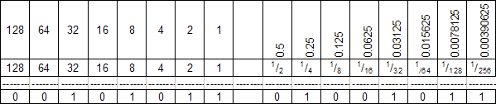
Fixed Point Numbers
Fixed point numbers are just an offset case of signed integers
Example: 37.55
  Get roughly equivalent precision by expressing in 128ths (7 bits), but it’s common to work in groups of 4 (16ths) or 8 (256ths), so let’s use 8 bits after the radix:
    Multiply by 2⁸ (256)
    Convert to binary
    Shift radix left by 8

Slide 12
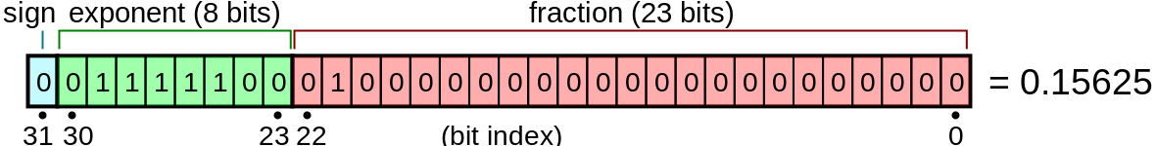
Floating Point Numbers (IEEE 754*)
Single precision (32-bit)
IEEE 754 includes standards from 16-bit (half precision) to 256-bit (octuple precision) floating point.
Special values
  exponent bits set to zero -> zero (also allows for -0!)
  Exponent bits all set and all fraction bits clear -> Infinity
  Exponent bits all set and some fraction bits set -> NaN
Leading 1 assumed (why?)
*became a standard in 1985

Slide 13
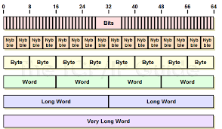
Grouping Bits in Modern Computers
Hardware will generally not group bits exactly like this
  Still tend to group things in 8-bit bytes
  The term “word” is used generically
This took a long time to evolve. Examples
Some old computers (IBM, PDP) had 6-bit bytes
CDC mainframes had 60-bit words, with totally different encoding.

Slide 14
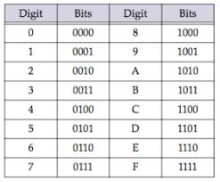
Representing Groups of Bits
Regardless of their use, groups of bits can always be compactly represented with hexadecimal numbers
  Each byte is represented by a two-digit hex number 00->FF, where each digit represents 4 bits
We can then represent larger groups of bits by larger hex numbers, while still respecting byte boundaries
  One byte is two hex digits
  Historically, 6-bit bytes were represented by two digit octal.

Slide 15
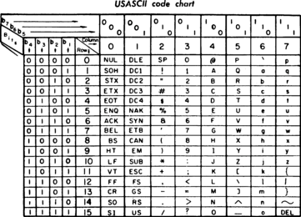
Representing Characters
The most common character
encoding is American Standard
Code for Information Interchange
(ASCII), in which each 8-bit byte
represents one character
In recent years, the 16-bit
“Unicode” standard has emerged
to accommodate foreign alphabets as well as a wide range of special characters.

Slide 16
Evolution of Precision
Numbers used to default to 16-bit precision
  Unsigned range: 0 to 65,535
  Signed range: -32,768 to +32,767
  This was standard for PC until the mid-1990s
All systems eventually moved to 32-bit
  Unsigned range: 0 to ~4 billion
  Signed range: -2 billion to +2 billion
All modern systems are 64-bit
  Unsigned range: 0 to 18 quintillion
  Signed range: -9 quintillion to 9 quintillion
The current release of Python is 64-bit, but Python handles integers in a special way that allows arbitrarily large range.

Slide 17
Integer Mathematical Precision
Integer math is exact!
  You’ll always get the correct answer until it overflows.
    For signed 64-bit this is a pretty large number, but we deal with very large numbers.
    Can happen pretty quickly with multiplication.
Python “int” objects have arbitrary size.
  Necessary size is determined when the object is initialized
  Numerous internal methods give details about the structure
  Integer operations will never overflow or have round-off errors!
  (Jupyter example shortly)

Slide 18
Important differences between Python and Other OO Languages…
Both C++ and Java distinguish between “primitive” data types and “objects”
  Primitives: integer, floating point, character, etc. These have no inherent methods!
  Objects: More complex structures that include data and associated methods.
Python has only objects, even for simple data types:
  Everything has methods.
  This leads to more versatility
  The distinction is between “mutable” and “immutable”, which we’ll discuss shortly.

Slide 19
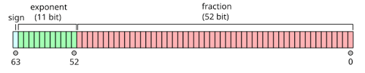
Floating Point Precision in Python
While C/C++ and Java distinguish between ”float” (32-bit) and “double” (64-bit) numbers, 64-bit Python “float” is always 64-bit.
Range:
Precision: 52 binary digits ~15 decimal digits
Multiplication
  Add exponents
  Multiply fractions (including implicit 1)
  Still only have 52-bit precision
Addition
  Right-shift smaller number so exponent matches larger number
  Add fractions (including implicit 1)
  Will round off if one number is > ~2*53 smaller than the other.

Slide 20
Other Number Types
When it comes to built-in number types, Python has ONLY
  int: unlimited size integers (math extremely inefficient)
  float: floating point with precision of the OS (now always 64-bit)
Sometimes, we’ll want other things
  Integers of fixed bit length
  Floating point numbers with different bit lengths (32 or 128)
  This is extremely important when calling routines in C/C++ and other languages.
This functionality will be provided by the “Numerical Python” (numpy) library, which we’ll introduce shortly.
Boolean (bool) variable
  Values of “True” or “False”. Can be thought of as a 1-bit integer

Slide 21
tuples, lists, and keyed lists (dicts)
Ordered sets:
  ”tuples” are ordered sets of objects in which individual items CANNOT be modified
  “lists” are ordered sets of objects in which individual items.
    Lists of numbers are referred to as “arrays”, but we’ll do our array math with numerical python (numpy)
Keyed sets
  Sets in which elements are addressed by keyword are called “keyed lists” or “dicts”

Slide 22
Mutable vs. Immutable
Simple objects in Python are “immutable”, meaning they can’t be changed once created.
  This is generally associated with “pass by value”, although the way Python implements it is kind of weird.
More complex objects are “mutable”, meaning that objects can be changed once they are created
  When on object is equated to another, it is “passed by reference” rather than creating a new object.
  (go to notebook demos)

